Slide 1
SEC572
Week 6
Implementation Plan

Slide 2
Rubric
Criteria | Total
Include problem statement slide from previous deliverable | 5
Include recommended solution slide from previous deliverable | 5
Implementation flow diagram (Malware, BYOD, Encryption) | 15
Cost-benefit analysis (CBA) | 15
Solution validation | 15
Solution evaluation and continuous improvement | 15
Decommission | 15
Legal, ethical and cultural considerations | 15
Total | 100

Slide 3
Problem Statement
Threat Protection Software outdated
Managing project complexity files
Employee Verification to access building
DDoS & Malware Attacks
No physical deterrents to access Communication Room

Slide 4
Alternative Security Controls
Incident Response – Corrective
Detective – Auditing
Technical Controls – Facial Recognition
Fingerprint Scanner
Physical Control – CCTV Locks
Biometric Recognition

Slide 5
CCTV#4
Comm
Room
Locked Door
Facial Recognition
Office Fingerprint Biometric Access
Highway#2
Honeypot
Highway#1
CCTV#1
Switch
Segmentation
Router
DVR
Employee
Entrance
CCTV#2
Internet
Remote PC
CCTV#3
Highway#3
PC Wifi
CCTV#5

Slide 6
This project is
beneficial
to pursue due to
abundance of
Capital.

Slide 7
Implementation SOP
Preparation: Automating of scanning INFORM network for abnormal traffic patterns and behaviors and IOC (Indicator of Compromise) for identifying breaches.
Detection/Analysis: Prioritizing incidents when multiple attacks are occurring, noticing the hallmarks of an incident happening or has happened (indicators) or (Precursors) determining if an incident will happen in the future. Antivirus software alerts and documenting SOPs (Standard Operating Procedures).
Containment/Eradication: Isolating networks that are compromised, end processes that are malicious, containing threat actors using honeypots and blocking suspicious IP address real-time. Automated response systems work best here.
Recovery: Using SOPs to minimizing downtime and operational impacts to INFORM. Utilizing disk imaging, data mirroring, backups, integrity, Raid and multiple servers.
Post Recovery: Lessons learned, training, and implementing and amending living the SOP.
Cyber Security Resources:
Incident Response Team: Specialized group, trained and tested.
IT Security Management: Corporate support.
Compliance Officers: Intricate knowledge of compliance rules.
Technical Staff: Team in the trenches.
User Community: Public that sees everything.

Slide 8
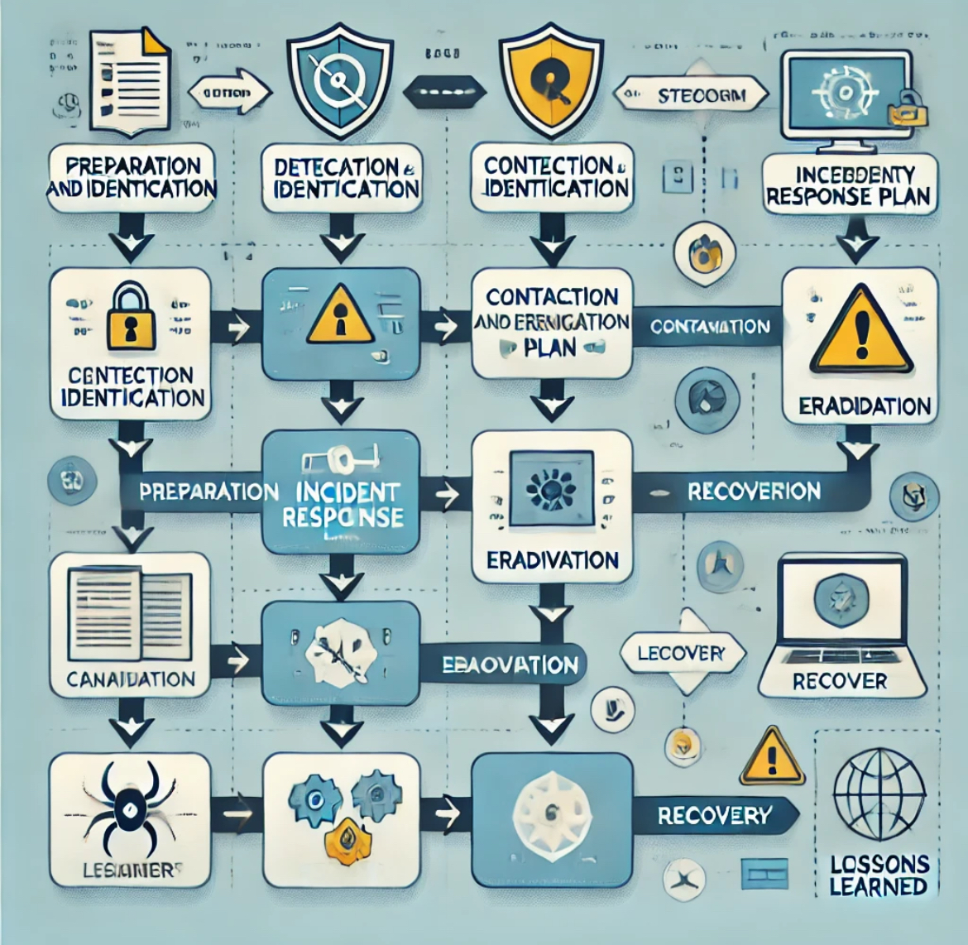
Implementation Flow Diagram

Slide 9
Solution Validation
The testing phase will run for a period of 4 months
The Pilot will run for 4 months
INFORM will have a total of 50 participants
The KPI, stress testing, sandboxing environments, and auditing

Slide 10
Evaluation and Continuous Improvement
After Penn Testing, review of the findings from employing white hackers and stress testing, the network will have data that is sound to analyze. As the honeypot allows for containment, the sandbox will allow for further forensics.
Keeping living policy and procedure and lessons learned after an incident is how updating will occur.
Quarterly the reassessment will take place.

Slide 11
Decommissioning
Decommissioning process:
Planning and taking stock of the data, software and systems
Data backup of critical information that are in compliance
Sanitization, destruction of hard drives
Degaussing using a high-powered magnet to remove data
Logging all data: The solution data will be encrypted and backed-up
Decommissioning Software: Uninstall properly after getting approval to do so.
Monitoring after the decommission is important as well.

Slide 12
Legal, Ethical and Cultural Considerations
Safeguarding information requires policy and planning. For the transportation industry, keeping the critical data safe is the up most importance along with following the guidelines such as ePHI.
MFA is the prescribed strategy for the transportation industry. Using a level of security clearance to have no write-up policy and no write-down.
Consistent training and computer learning environments are the way to train employees about threats internally and externally.

